Slide 1
Chapter 3 – Working environment overview
Artificial Intelligence

Slide 2
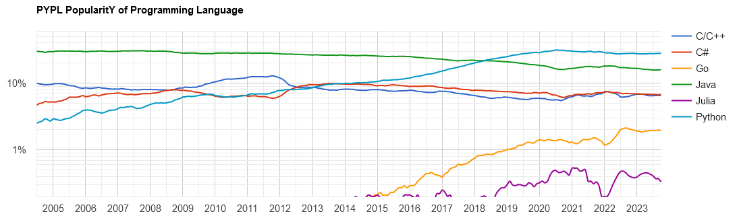
How to AI?
We’ll be using Python for AI
Why?

Slide 3
How to AI?
To do AI, you need libraries
These all exist for Python, and are well maintained, mostly open source and extensively documented
Also, everyone is using Python these days, so why shouldn’t we?
But there are a number of ways in which to use Python:
Anaconda
Anaconda in Docker
Plain Python and pip
Virtual Environments
The cloud (aka Colab)

Slide 4
Disclaimer
The following is, at times, quite a confusing slide-deck. That is because it explains many ways of solving the same problem.
The goal is to provide an overview of what is possible. You may encounter any of these solutions in the wild. They all have their benefits.
At the end there will be another file explaining what you actually need to install.

Slide 5
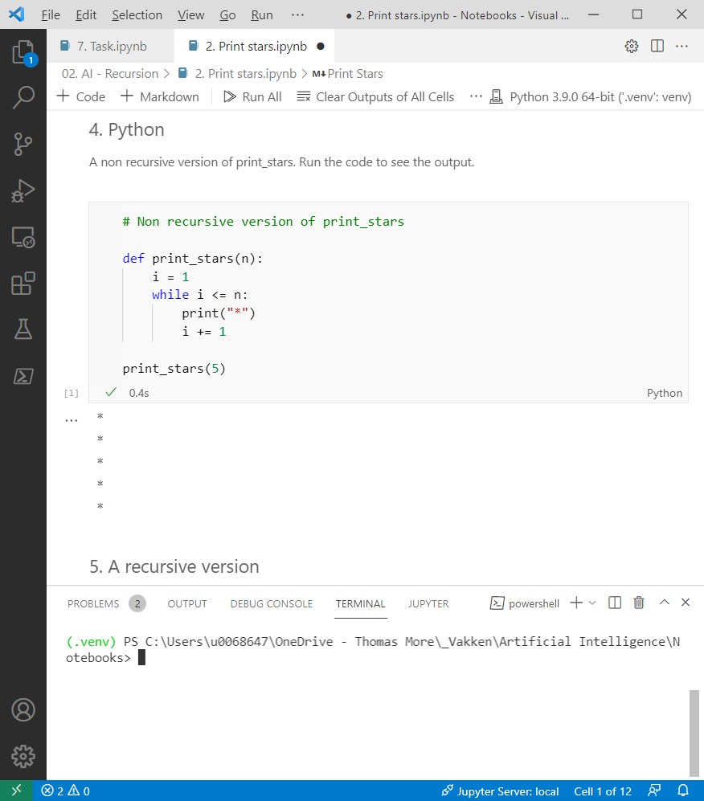
We need notebooks
Notebooks mix code and markdown-style text. This isn’t just good when creating course-material, it’s also very nice when doing AI for yourself (because you can easily document all your attempts).
You can run these in VSCode, or in PyCharm, run them from a virtual environment or from Anaconda, …

Slide 6
What is Anaconda
Anaconda is actually a package manager for Python, helping you to [un]install libraries and update them. But Anaconda is also a gui-program that you can install. In these slides, we'll usually refer to the Gui when we say "Anaconda".
Anaconda (the gui) used to be the industry default for Data science. Everyone used it, so it must be good. Installation was(/is) pretty straightforward too...
Positives
Easy to install
Has all the good libraries installed by default
Packages are verified (not the case when using PIP)
Negatives
Takes over your Python-installation, forcing you to always use anaconda

Slide 7
Anaconda in the past tense?
Anaconda pre-installed a lot of the libraries (pandas, numpy, Jupyter), which is easy for beginners
It also provided an easy way to get Jupyter notebooks running before VSCode existed
But it didn’t use the default virtual environments and in stead used conda, which also worked but it was a new tool to learn
It’s still used in some organizations (research) but a less than before

Slide 8

Visual Studio Code
VSCode is an IDE Microsoft made a couple of years ago. The idea was to create an open-source IDE that could be used for any programming language on any system.
And they succeeded.

Slide 9
What is docker?
This is. (There are non-MS-explanations, but this one nicely covers the basics.)
What is Docker?
Docker is an open-source project for automating the deployment of applications as
portable, self-sufficient containers that can run on the cloud or on-premises. Docker is
also a company that promotes and evolves this technology, working in collaboration
with cloud, Linux, and Windows vendors.
Why use docker?
Because there's a ready-made Anaconda container that simply works

Slide 10
Plusminus
Positives
Very easy to install
Doesn't take over your local Python-installation
Also has all the good libraries installed by default
Negatives
Requires an extra layer on your system
But only on Windows, in Linux, it's really fluent
A bit more work to install additional libraries

Slide 11
Anaconda in docker on a server (-cluster)
Positives
Doesn't use any processing power on your laptop
Everyone uses the same dev-environment
Really easy to deploy to racks with a lot of computing power
Negatives
You need server infrastructure (and a devops engineer) for that

Slide 12
Installation
Install Linux
Install Docker
When you run docker in windows it automatically installs the Windows Subsystem for Linux (WSL) and installs docker in there. It works nicely.
Anyway, after installing docker:
Run docker pull jupyter/datascience-notebook
Run docker run -it --rm -p 8888:8888 jupyter/datascience-notebook

Slide 13
Installing everything separately
First you download and install Python
Next, you install VSCode
Open a folder in VSCode and create a virtual environment
Now start using a Jupyter notebook and install all libraries you need using ! or %

Slide 14

Why?
Positives
Very rigorous control over what get's installed and what not
Use your favorite IDE to do AI
Lightweight setup, easily reproducible to github or a server
Negatives
(A bit) more work to get everything installed and cooperating

Slide 15

And Jupyter?
You can create a notebook in VSCode, but you can also work on a notebook in a browser.
You can install Jupyter as a library in Python (using pip) and run it. It wil automatically open a browser…
https://jupyter.org/install

Slide 16
Why use a virtual environment?
The problem:
You wrote some code half a year ago, updated Anaconda (or your libraries) and now the code doesn't work anymore because the libraries have become better (which is good), but they also changed some function-calls.
The solution:
You create a virtual environment with this Python and that library and store your project inside of that environment. When the project is done, you save the entire environment in a folder that you can reuse later on, with all the libraries in the versions you need.

Slide 17

Example
print "hello world"
print("hello world")
The first worked in Python 2 but doesn't in Python 3. Code you wrote many years ago without brackets won't work anymore.
But you want that code to work, even though it's built on older technology and relies on libraries that have been proven to be inefficient or unsafe.

Slide 18
Unsafe?
Yes, using older, not-updated libraries can be unsafe.
Yet we're not writing a new banking-App, but extracting data from files and reforming it, so working-but-not-so-safe-code is better than not-working-code.
And you're aware of the fact that you are using an old version, so every time you start a new project, you create a new environment with updated libraries and work in that environment.

Slide 19
Using virtual environments in Python
Using virtual environments in Python is a great way of keeping a project “in working condition” and also of not installing all libraries in the basic Python-interpreter.
Create a new folder
Open VSCode in that folder (File – open folder)
In terminal, type
python -m venv venv
venv/Scripts/activate
The prompt changes to “(foldername) c:\...”

Slide 20
Do we need venv in docker?
No, when using anaconda (or Jupyter) in docker, we simply use one container per project. The Dockerfile will take care of installing the requirements. When it needs training move it over to the Kubernetes-cluster with massive GPU, when no longer working on it, store in Github.
Github, by the way: setup a continuous integration-pipeline (the CI in CI/CD) to use the same environment with dozens of developers. Works great…

Slide 21
Saving a virtual environment
When uploading a project to github, you never upload the venv-folder
It contains way too many files that are downloaded from the internet
In stead, you export the contents of “pip freeze” to a file (“requirements.txt”)
Pip freeze > requirements.txt
Then you push it to github and when you clone it, install the libraries in the file
Pip install –r requirements.txt
Beware: freezing is a picture taken at a certain time, it doesn’t follow installation of new libraries

Slide 22
colab.research.google.com
Google hosts a cluster of computers (a rather large one) and you can use some of that compute to run Python-code. It’s a zero-setup way of doing data science or AI.
It integrates with your google drive, which makes it easy to upload and download existing files. You can also share files this way, or even use github.

Slide 23
Running code
Plain Python, use pip for libraries
Install Anaconda
Install Jupyter notebooks
Run Jupyter in a webbrowser (Anaconda or Jupyter)
Or use VSCode (plain Python or Anaconda)
Always use virtual environments
Consider using Github
When working with more than one developer: always use Github (or gitlab)

Slide 24


Or maybe?
Shouldn’t we be looking into Julia, since it’s newer
And therefore, by definition, cooler
When switching to Julia might be a good idea:
Performance is a bottleneck: Julia’s just-in-time (JIT) compilation can significantly outperform Python in computationally heavy tasks
You're doing a lot of numerical computing or scientific ML: Julia was designed for numerical work and is strong in scientific computing, differential equations, and modeling
You want a cleaner “one-language” workflow: Unlike Python (which mixes with C/C++/Fortran under the hood for speed), Julia lets you write high-performance code directly without leaving the language

Slide 25

Or maybe?
Shouldn’t we be looking into Julia, since it’s newer
And therefore, by definition, cooler
When not to switch:
You're already productive in Python: Python has mature ML libraries (e.g., scikit-learn, PyTorch, TensorFlow, XGBoost) and a huge community. Switching means losing access to some of that maturity, unless you can interop with Python via PyCall.
You use a lot of prebuilt ML tools: Julia's ML ecosystem (e.g., Flux.jl, MLJ.jl) is growing but still behind Python in terms of documentation, tutorials, and robustness.
You collaborate with others: Python is the standard in most research and industry ML workflows. Introducing Julia may cause friction unless your team is on board.

Slide 26
How to continue?
If you’re on a shared or public device without administrator-permissions, use google colab.
If you’re on your own laptop and hope to keep on developing, try Python with VSCode. (See enclosed PPTX for installation.)
If you’re already using anaconda, keep using it.

